Slide 1
It's Alive! Modern Visualforce in Lightning Experience
Visualforce Live Controller
Mike Senn, Visualforce Platform Developer
@mpsenn

Slide 2

Forward-Looking Statement
Statement under the Private Securities Litigation Reform Act of 1995
This presentation may contain forward-looking statements that involve risks, uncertainties, and assumptions. If any such uncertainties materialize or if any of the assumptions proves incorrect, the results of salesforce.com, inc. could differ materially from the results expressed or implied by the forward-looking statements we make. All statements other than statements of historical fact could be deemed forward-looking, including any projections of product or service availability, subscriber growth, earnings, revenues, or other financial items and any statements regarding strategies or plans of management for future operations, statements of belief, any statements concerning new, planned, or upgraded services or technology developments and customer contracts or use of our services.
The risks and uncertainties referred to above include – but are not limited to – risks associated with developing and delivering new functionality for our service, new products and services, our new business model, our past operating losses, possible fluctuations in our operating results and rate of growth, interruptions or delays in our Web hosting, breach of our security measures, the outcome of any litigation, risks associated with completed and any possible mergers and acquisitions, the immature market in which we operate, our relatively limited operating history, our ability to expand, retain, and motivate our employees and manage our growth, new releases of our service and successful customer deployment, our limited history reselling non-salesforce.com products, and utilization and selling to larger enterprise customers. Further information on potential factors that could affect the financial results of salesforce.com, inc. is included in our annual report on Form 10-K for the most recent fiscal year and in our quarterly report on Form 10-Q for the most recent fiscal quarter. These documents and others containing important disclosures are available on the SEC Filings section of the Investor Information section of our Web site.
Any unreleased services or features referenced in this or other presentations, press releases or public statements are not currently available and may not be delivered on time or at all. Customers who purchase our services should make the purchase decisions based upon features that are currently available. Salesforce.com, inc. assumes no obligation and does not intend to update these forward-looking statements.
Notes:
Key Message Salesforce is a publicly traded company. Customers should make buying decisions only on the products commercially available.
Talk Track Before I begin, just a quick note that you should base your purchasing decisions on products and services that are currently available.

Slide 3
Agenda
Page Out-of-Sync Problem
Demo 1: Full Page Rerender
Lightning Data Services (LDS)
Rerendering and Live Controller Flow
Demo 2: Custom Controllers
Viewstate
Using Lightning Web Components in Visualforce

Slide 4


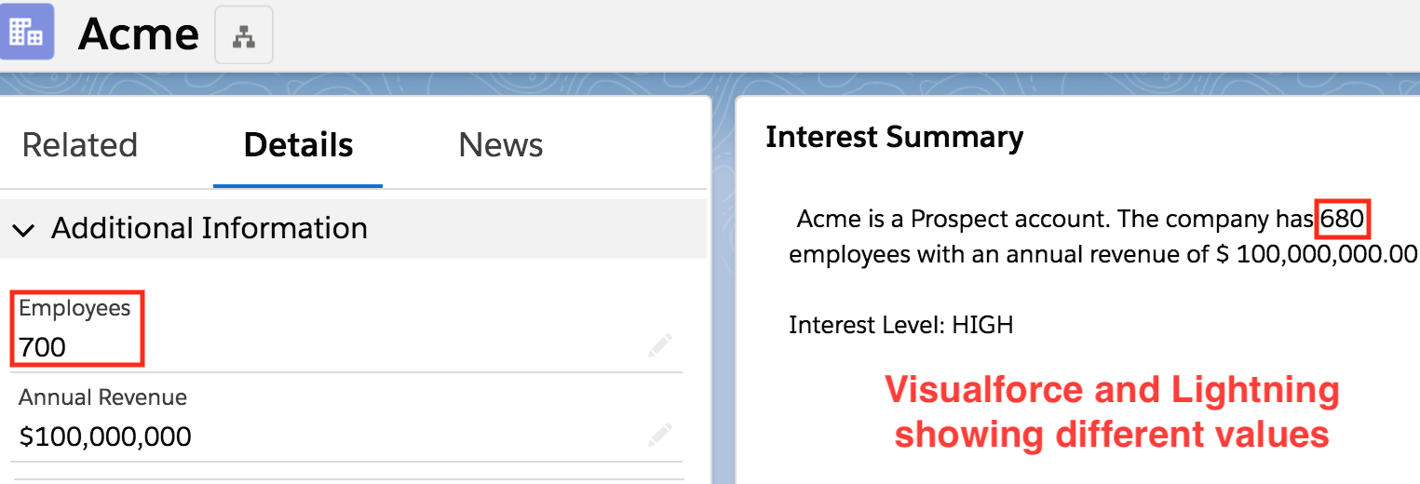

Page Out-of-Sync Problem
Visualforce, Lightning, and the backend don’t talk to each other.
Visualforce pages show stale data until you refresh.
Leads to incorrect decisions based on old data.
?
Apex triggers
Roll-up summary fields
Process builder
API updates

Slide 5
Live Controller to the Rescue!
Open Pilot Summer ‘19
It’s alive!
<apex:liveController/> is a new VF component that responds to changes to the record being shown.
Performs full or partial rerendering of the VF content.
Works alongside other Lightning Components or if a VF page is solo on the page.
Regardless of the UI or process responsible for the change, the VF page will update.
BEST PART: One line of code!!

Slide 6
Demo: Live Controller
Open Pilot Summer ‘19
Full Page Rerender

Slide 7
Live Controller Flow
VF Component
Open Pilot Summer ‘19
Browser LEX
VF Page <iframe>
LDS
Record Cache
<apex:liveController/>
JavaScript
Lightning Components
LDS
VF Components
(3) Record Invalidation
(5) Update DOM
Client Side
Server Side
(4) Rerender VF
Salesforce backend
(2) Push to Client
Streaming API
Change Data Capture
(1) Record Changed
DB Hooks onCommit

Slide 8
Lightning Data Services (LDS)
LDS is the client-side data store used in Lightning, the code behind most of the UI.
Built-in Lightning components.
<force:recordData/> for custom components.
@wire(getRecord) and @wire(getRecordUi) for LWC components.
And now <apex:liveController> in Visualforce!
Apex triggers
Roll-up summary fields
Process builder
API updates

Slide 9
Rerendering Visualforce Content
Open Pilot Summer ‘19
Visualforce makes Ajax calls to render a page on the server with latest data.
Dynamically update DOM elements with up-to-date content.
You have control over which portions of the Visualforce content are updated and re-displayed.
<apex:page standardController="Account">
...
<apex:liveController rerender="myPanel"/>
<apex:outputPanel id="myPanel">
...
</apex:page>

Slide 10
Demo: Clearing Viewstate
Open Pilot Summer ‘19
Custom Controllers and Controller Extensions

Slide 11
Visualforce Viewstate
Open Pilot Summer ‘19
Viewstate is delivered with each Visualforce page request.
Controller fields and data are stored in viewstate.
Use Apex to clear controller fields.
public with sharing class DonationSiteExtension {
private ApexPages.StandardController ctrl; private Donation_Site__c site; private List<PieWedgeData> data;
public void resetMe() {
string id = site.id;
this.site = [...SOQL...];
this.data = null;
}
}

Slide 12

Visualforce Viewstate
Open Pilot Summer ‘19
Viewstate is delivered with each Visualforce page request.
Controller fields and data are stored in viewstate.
Use Apex to clear controller fields.

Slide 13
Tips and Tricks
Open Pilot Summer ‘19
Rolling out to your org on during Summer ‘19!
When using <apex:form> and <apex:liveController/> , Live Controller will disable rerendering if input elements change, to avoid overriding changes.
It’s recommended to only specify rerender portions of the form that don’t include input fields.
Best to use partial rerendering to avoid losing any UI state changes:
<apex:pageBlockSection> expanded/collapsed
Select tab of <apex:tabPanel>
Scroll location within an <apex:inputTextarea>

Slide 14



Lightning Web Components can be used in Visualforce!
GA Summer ‘19
@mpsenn
Create a Lightning “dependency” app (But kebab-case-component should be camel:CaseComponent)
Load components JUST LIKE loading other Aura components
<aura:application access="GLOBAL" extends="ltng:outApp" >
<aura:dependency resource="lightning:recordViewForm" />
</aura:application>
<apex:includeLightning />
<script>
$Lightning.use('c:dependencyApp', function() {
$Lightning.createComponent('lightning:recordViewForm', … );
});
</script>
How to use lightning-record-view-form

Slide 15
Fix Trees, adjust banner
https://github.com/mpsenn/trailheadx2019 @mpsenn @glacier4ce
Ready Visualforce for Lightning Experience with Lightning Stylesheets and More
Platform Point: Table 2 - 1:15 PM
Pierre-Marie Dartus - David Turissini Build Lightning Web Components Anywhere Room 2009 - 4:30 PM

